Slide 1

Computer Vision
Using OpenCv

Slide 2
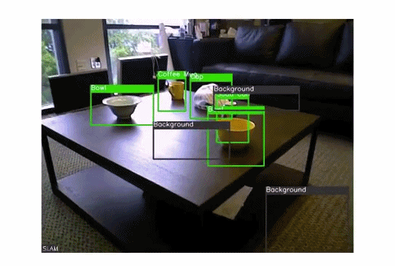
Computer Vision is a field of deep learning that enables machines to see, identify and process images like humans.

Slide 3

Why use OpenCV for Computer Vision Task?
Open Source Computer Vision library, started out as a research project at Intel. It’s currently the largest computer vision library
OpenCV contains implementations of more than 2500 algorithms
The first OpenCV version, 1.0, was released in 2006

Slide 4
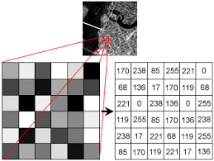
Reading, Writing and Displaying Images
Machines see and process everything using numbers, including images and text. How do you convert images to numbers - pixel values

Slide 5
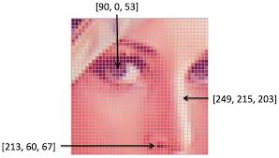
Why Gray Color?
Every number represents the pixel intensity at that particular location. In the above image, I have shown the pixel values for a grayscale image where every pixel contains only one value i.e. the intensity of the black color at that location.
color images will have multiple values for a single pixel. These values represent the intensity of respective channels – Red, Green and Blue channels for RGB images, for instance.

Slide 6
Face Detection Using OpenCv
OpenCV supports haar cascade based object detection. Haar cascades are machine learning based classifiers that calculate different features like edges, lines, etc in the image. Then, these classifiers train using multiple positive and negative samples.
Trained classifiers for different objects like faces,eyes etc are available in the OpenCV, you can also train your own haar cascade for any object.

Slide 7

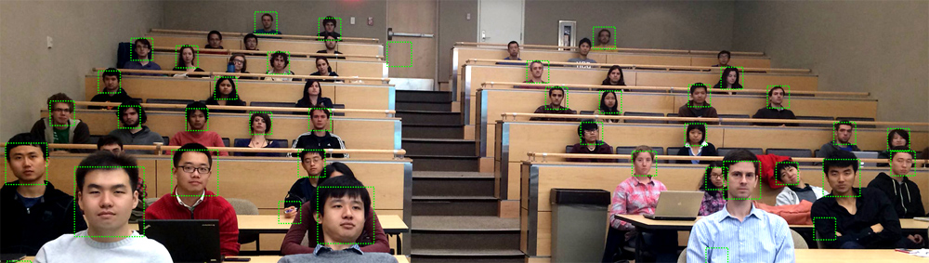
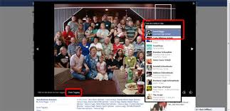
Applications of Face Detection
Facebook replaced manual image tagging with automatically generated tag suggestions for each picture that was uploaded to the platform
We are becoming used to unlocking our phones with the latest ‘face unlock’ feature. This is a very small example of how a face detection technique is being used to maintain the security of personal data.
Another interesting application of face detection could be to count the number of people attending an event (like a conference or concert). Instead of manually counting the attendees, we install a camera which can capture the images of the attendees and give us the total head count.

Slide 8
Setting up the System
Hardware/Software Requirements
A webcam or you can also use your laptop inbuilt camera.
(Core i5 7th Gen).
Using a GPU for faster video processing is always a bonus
On the software side, Any Operating System with python tool.

Slide 9
Install OpenCV
To install OpenCV, do a pip install of the library:
Pip install opencv-contrib-python
Download Haar-CascadeClassifier file
https://tinyurl.com/codegnan-cascade

Slide 10
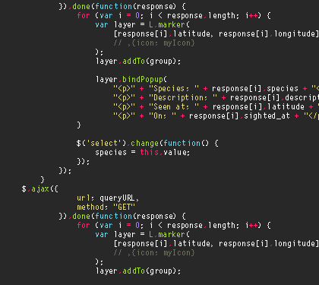
Code

Slide 11
Applications of Computer Vision
Industrial Robots
Autonomous Vehicle
Medical Image Processing
Missile Guidance
…

